Slide 1
PROJECT
Complaint Ticket Generator
By – Anjali Anil

Slide 2
Overview Of The Project
My project Complaint Ticket Generator is a ticketing system in which we have options to assign the tickets to right person, or right department. The system let’s you categorize, prioritize, and assign complaint tickets to other users or departments.

Slide 3
TABLE OF CONTENTS
04
01
02
05
03
06
Home Page
Register Page
Login Page
Confirmation Page
Project Features
Database of Login Page

Slide 4
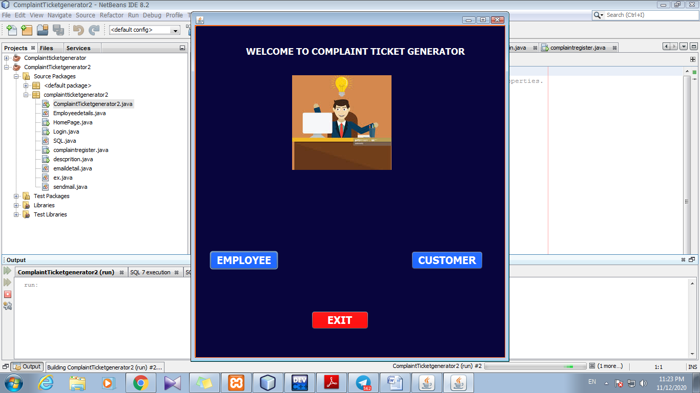
Home Page
This is the first page of my project from here the person who want to register their complaints as an Employee or a Customer can register by selecting from the options or can Exit to go back.

Slide 5
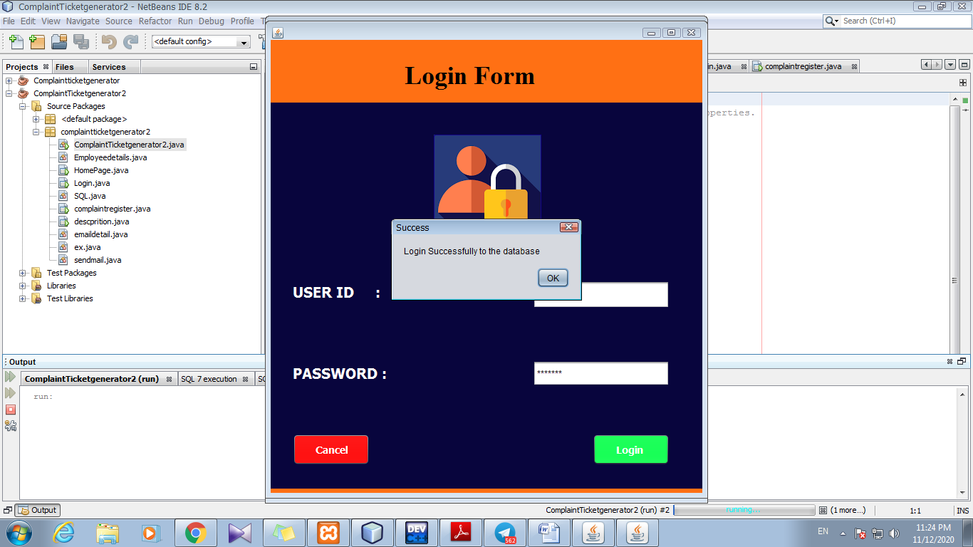
Login Page
After the home page the user will land on this Login page were the user will enter their User ID and Password and When after entering the data the user pressess login button .Then it shows “Login Successfully to the database”
if the data inputed by user is correct

Slide 6
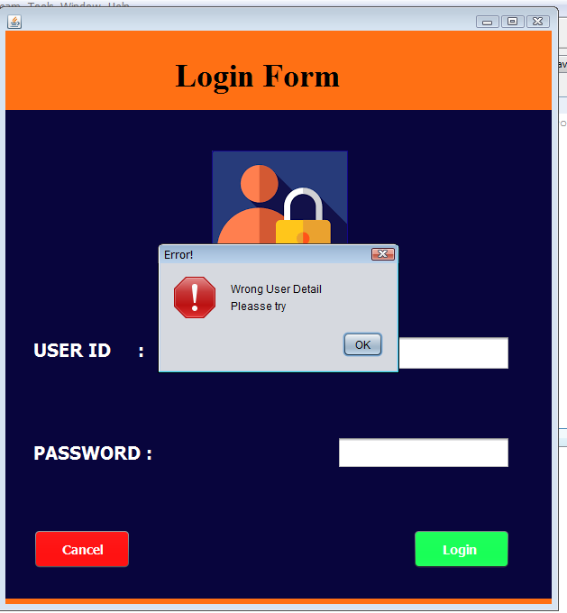
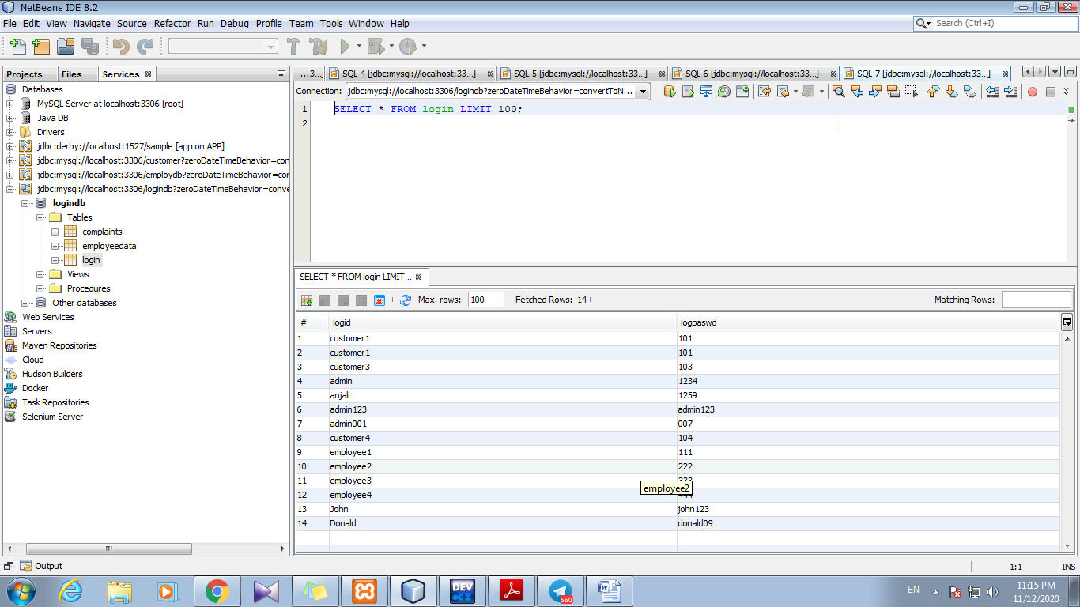
I have created a database in which all the usernames and passwords are stored, So If the user enters a wrong ID and password it shows
“Wrong User Details Please try”
and if he wants to go back use Cancel Button.

Slide 7
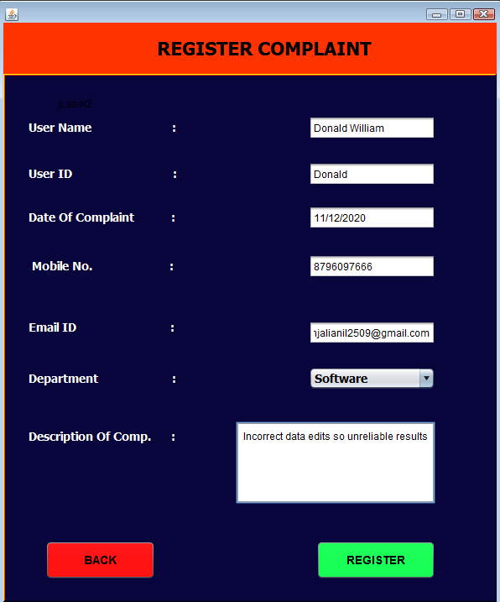
Register page
Here the user will fill all the details like User Name, User Id, Date of Compalint. Mobile no., Email Id, Department (Hardware, Networking, Security, Software) and Description Of complaint .

Slide 8
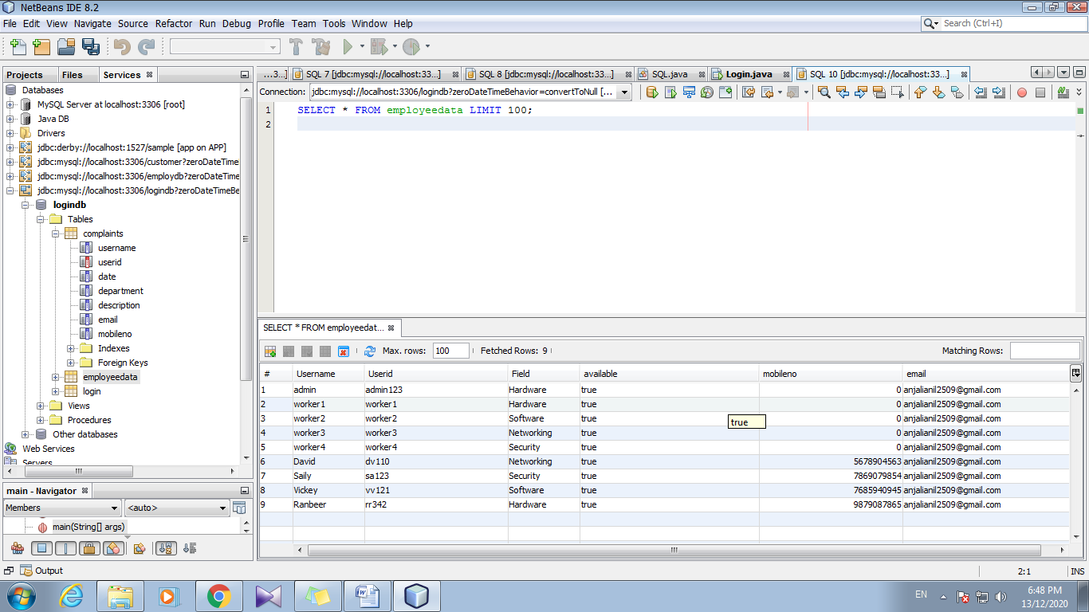
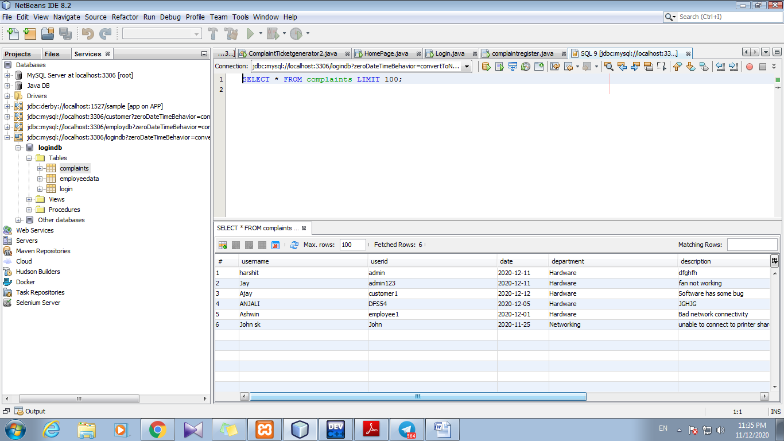
Available Workers
database
After user clicks the Register button all these details will be stored in a database. Which I have created as shown and if the user clicks on Back button then Login page will be opened.

Slide 9
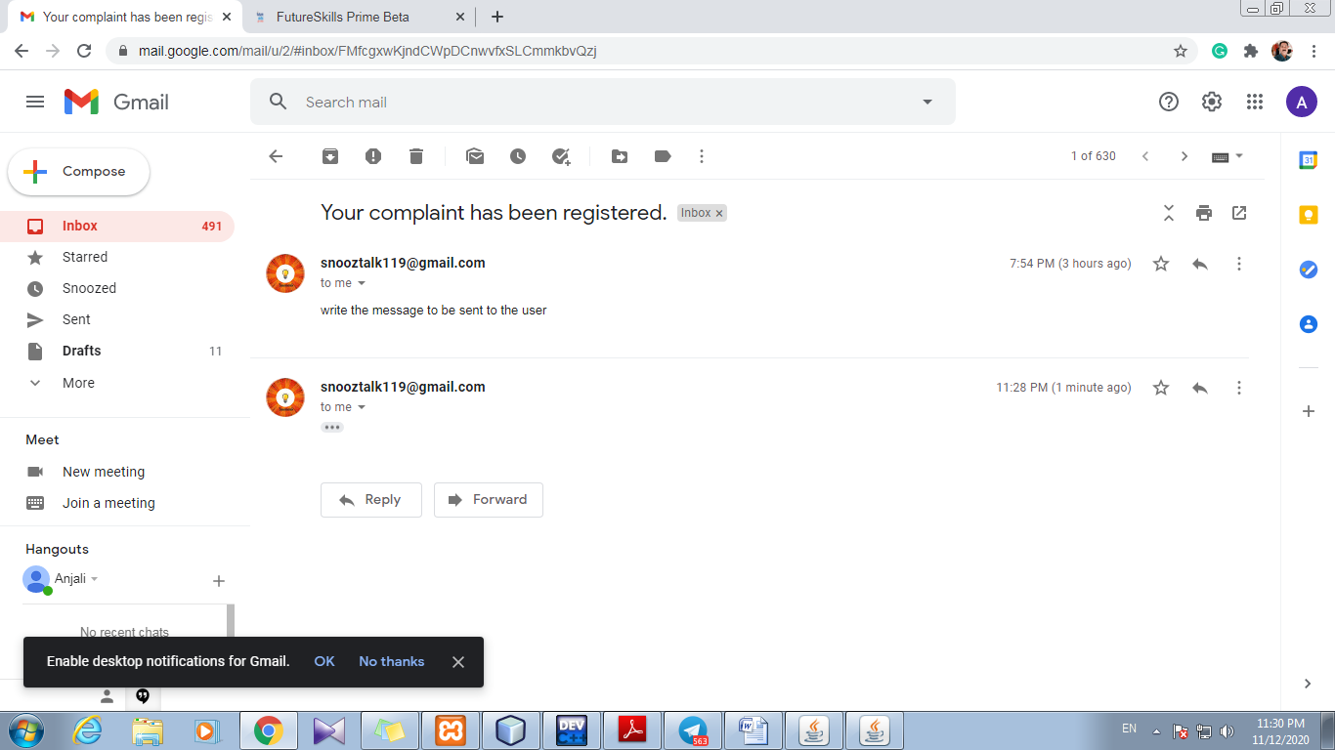
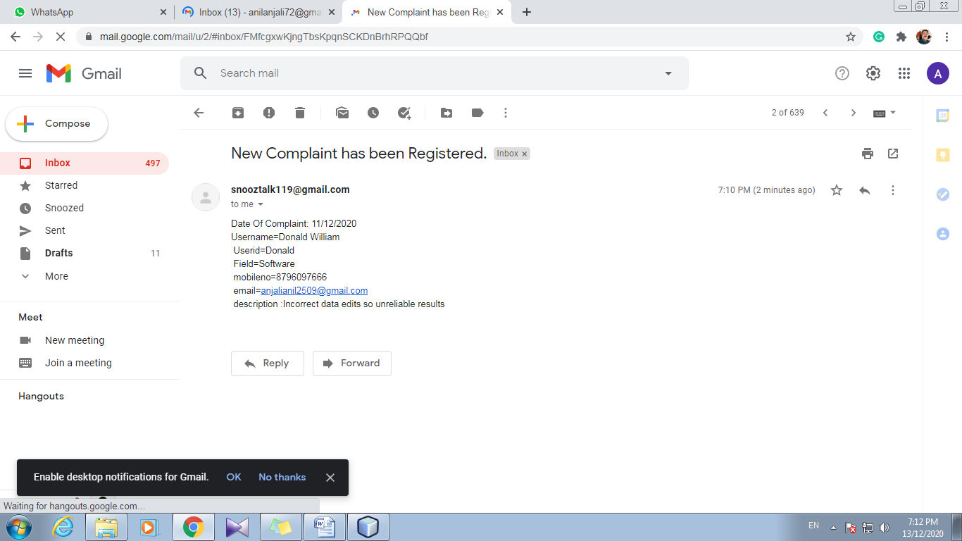
User
Worker
After the user clicks Register button an email will be received by the user in which message will be given that their complaint has been registered and other mail to the person whom this work has been is assigned to.

Slide 10
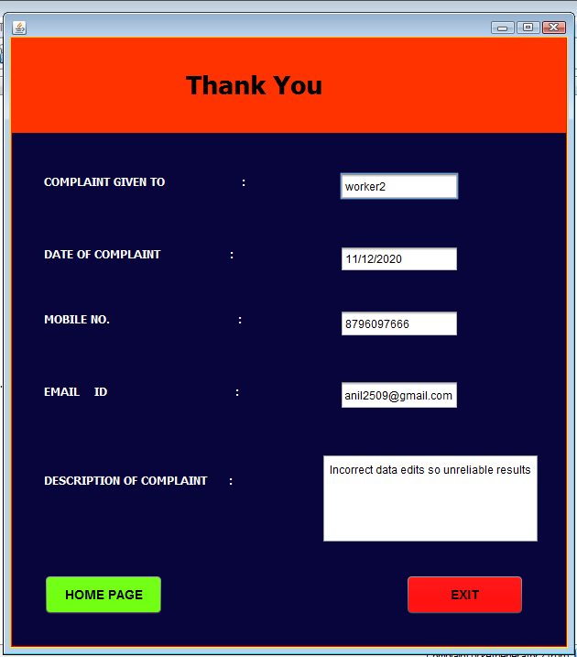
Confirmation Page
In this page whole summary of the complaint is shown to the user as the complaint is assigned to which worker date of complaint, mobile no., email id, description of complaint. Then he can choose to go back to Home Page or Exit.
User can also connect to the worker using phone or message

Slide 11
PROJECT
So my Project collects all support tickets from different channels and organizes them under one tab, to help agents respond to all of them.
This makes the employee's job of data entry into systems faster and has an improved quality.
The process helps to fetch the previous complaint details of the given customer ID.

Slide 12
Thank You
Made by – Anjali Anil

